Slide 1
Fundamentals of CRE
Chemical Reaction Engineering
By
Dr Salah N. Farhan
Senior lecturer. Chem. Eng. Dept.
College of Engineering
University of Diyala
Salah N. Farhan College of Engineering Diyala University

Slide 2
Fundamentals of CRE
Chapter 1: Mole Balances
Learning Resources
Learning Resources
Salah N. Farhan College of Engineering Diyala University

Slide 3
Fundamentals of CRE
Consider the general equation
The basis of calculation is always the limiting reactant. We will choose A as our basis of calculation
and divide through by the stoichiometric coefficient to put everything on the basis of "per mole of A".
The conversion X of species A in a reaction is equal to the number of moles of A reacted per mole of A fed.
Conversion | top
Batch | Flow
Salah N. Farhan College of Engineering Diyala University

Slide 4
Fundamentals of CRE
What is the maximum value of conversion?
For irreversible reactions, the maximum value of conversion, X, is that for complete conversion, i.e. X=1.0. For reversible reactions, the maximum value of conversion, X, is the equilibrium conversion, i.e. X=X_{e}.
Batch | Flow
Moles A remaining = N_{A} = Moles A initially - Moles A reacted | Rate of Moles of A leaving F_{A} = Rate of Moles of A fed - Rate of Moles of A reacted
N_{A}= N_{A0} - moles A initially * (moles A reacted)/(moles A fed) | F_{A}= F_{A0} - Rate of moles A fed * (moles A reacted)/(moles A fed)
Salah N. Farhan College of Engineering Diyala University

Slide 5
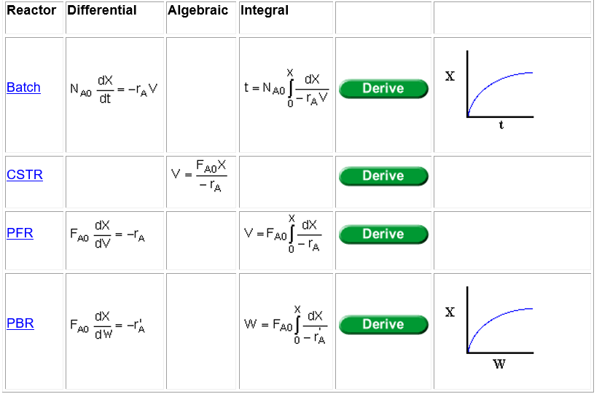
Fundamentals of CRE
Design Equations
The design equations presented in Chapter 1 can also be written in terms of conversion.
The following design equations are for single reactions only. Design equations for multiple reactions
will be discussed later.
Salah N. Farhan College of Engineering Diyala University

Slide 6
Fundamentals of CRE
Salah N. Farhan College of Engineering Diyala University

Slide 7
Fundamentals of CRE
Salah N. Farhan College of Engineering Diyala University

Slide 8
Fundamentals of CRE
Salah N. Farhan College of Engineering Diyala University

Slide 9
Fundamentals of CRE
Salah N. Farhan College of Engineering Diyala University

Slide 10
Fundamentals of CRE
Salah N. Farhan College of Engineering Diyala University

Slide 11
Fundamentals of CRE
Salah N. Farhan College of Engineering Diyala University

Slide 12
Fundamentals of CRE
Salah N. Farhan College of Engineering Diyala University

Slide 13
Fundamentals of CRE
Salah N. Farhan College of Engineering Diyala University

Slide 14
Fundamentals of CRE
Salah N. Farhan College of Engineering Diyala University

Slide 15
Fundamentals of CRE
Salah N. Farhan College of Engineering Diyala University

Slide 16
Fundamentals of CRE
Salah N. Farhan College of Engineering Diyala University

Slide 17
Fundamentals of CRE
Salah N. Farhan College of Engineering Diyala University

